Slide 1

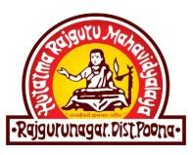
Khed Taluka Shikshan Prasarak Mandal’s
Hutatma Rajguru Mahavidyalaya, Rajgurunagar, Pune- 410505
TYBBA(CA)
A
Presentation
On
“Digital Marketing”
NAME:Wayal arati bharat
ROLL NO:62
GUIDE: Prof: R.S.Jadhav

Slide 2
Introduction
Digital marketing, also known as online marketing, is the use of digital media to promote brands and connect with potential customers. It can include email, social media, websites, and mobile apps.

Slide 3
Key Components of Digital Marketing
SEO
PPC Advertising
Content Marketing
Social Media Marketing
Email Marketing
Affiliate Marketing

Slide 4
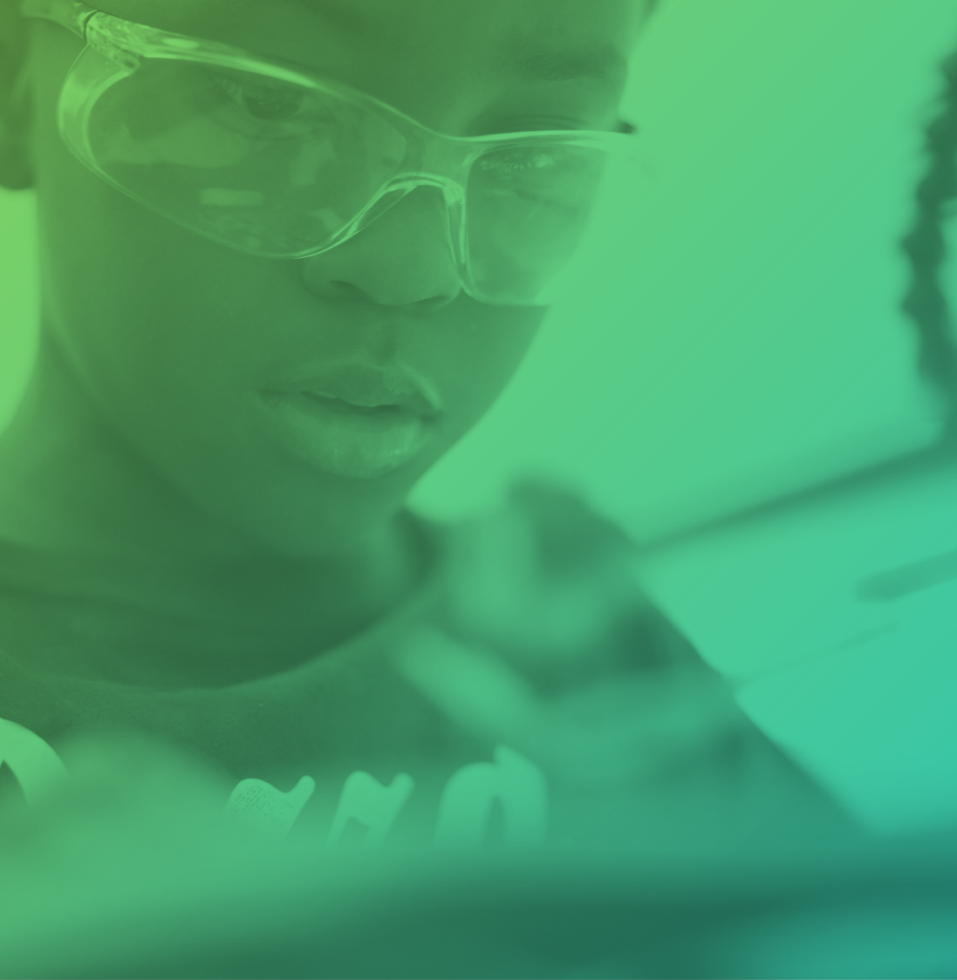
Trends in Digital Marketing
AI & Automation
Influencer marketing
Voice search optimization
Video marketing

Slide 5

Digital Marketing Analytics & Tools
Google Analytics
Social media insights
SEO tools: SEMrush, Ahrefs, Moz

Slide 6
Difference
Traditional Marketing
Digital marketing
Traditional Marketing is a form of marketing that uses conventional methods/offline media to reach the target audience.
Digital Marketing is a form of marketing that uses online platforms and digital technologies to reach the target audience.
It uses offline channels like television, direct mail, radio, telemarketing, and billboards.
It is a two-way communication marketing approach and allows the organisation and audience to interact with each other,

Slide 7

Conclusion
Digital marketing is a vital tool for businesses to connect with customers online. It has evolved with new technologies and can help businesses reach a wider audience, improve brand recognition, and increase sales.

Slide 8
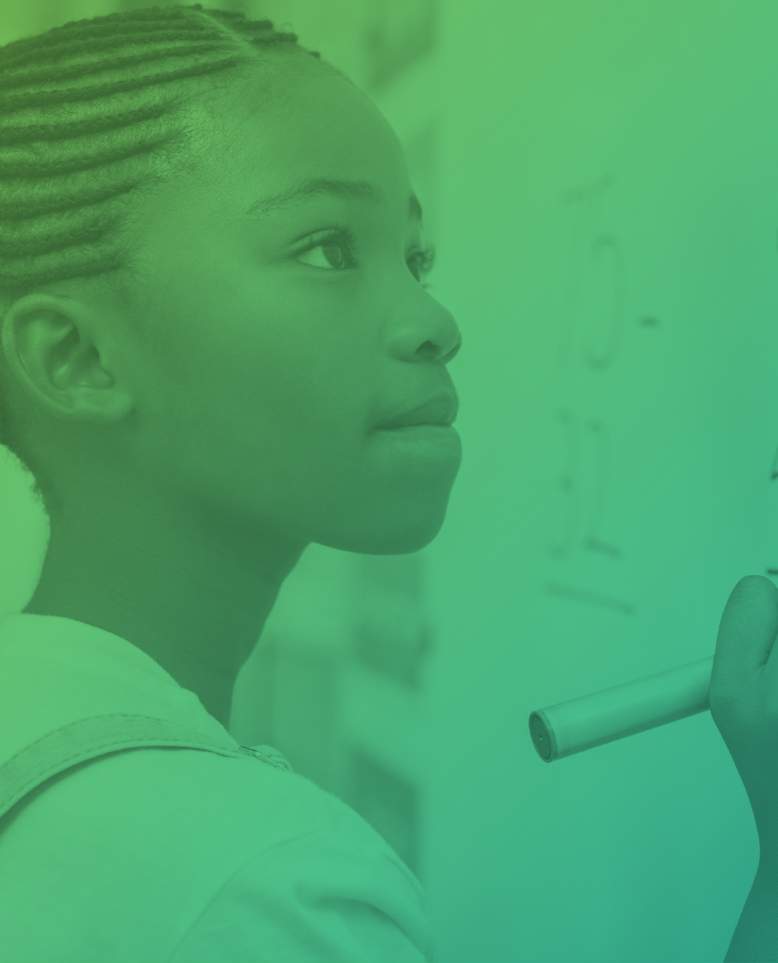
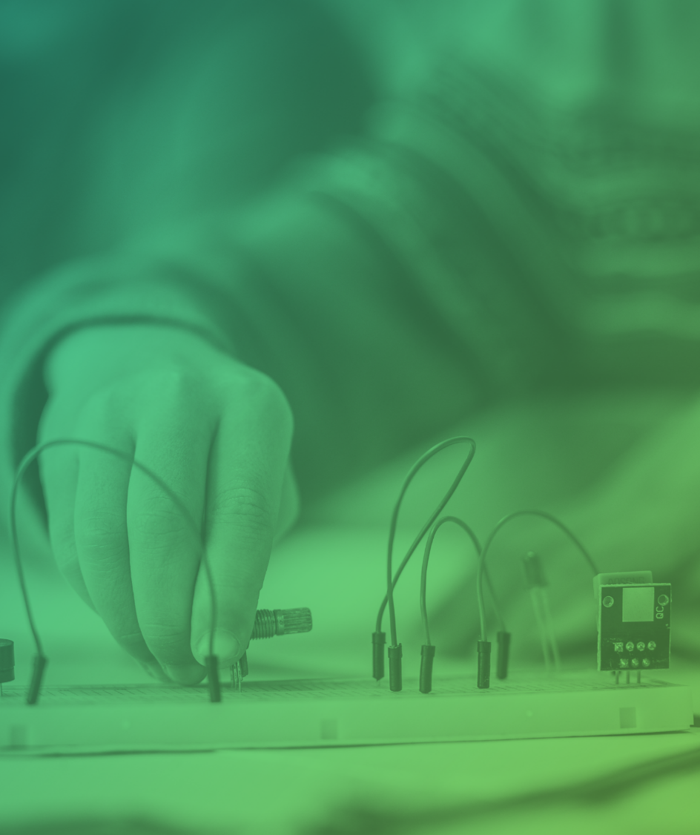
Thank you

